Slide 1
PRE-HEALTH PRESENTATION

Slide 2
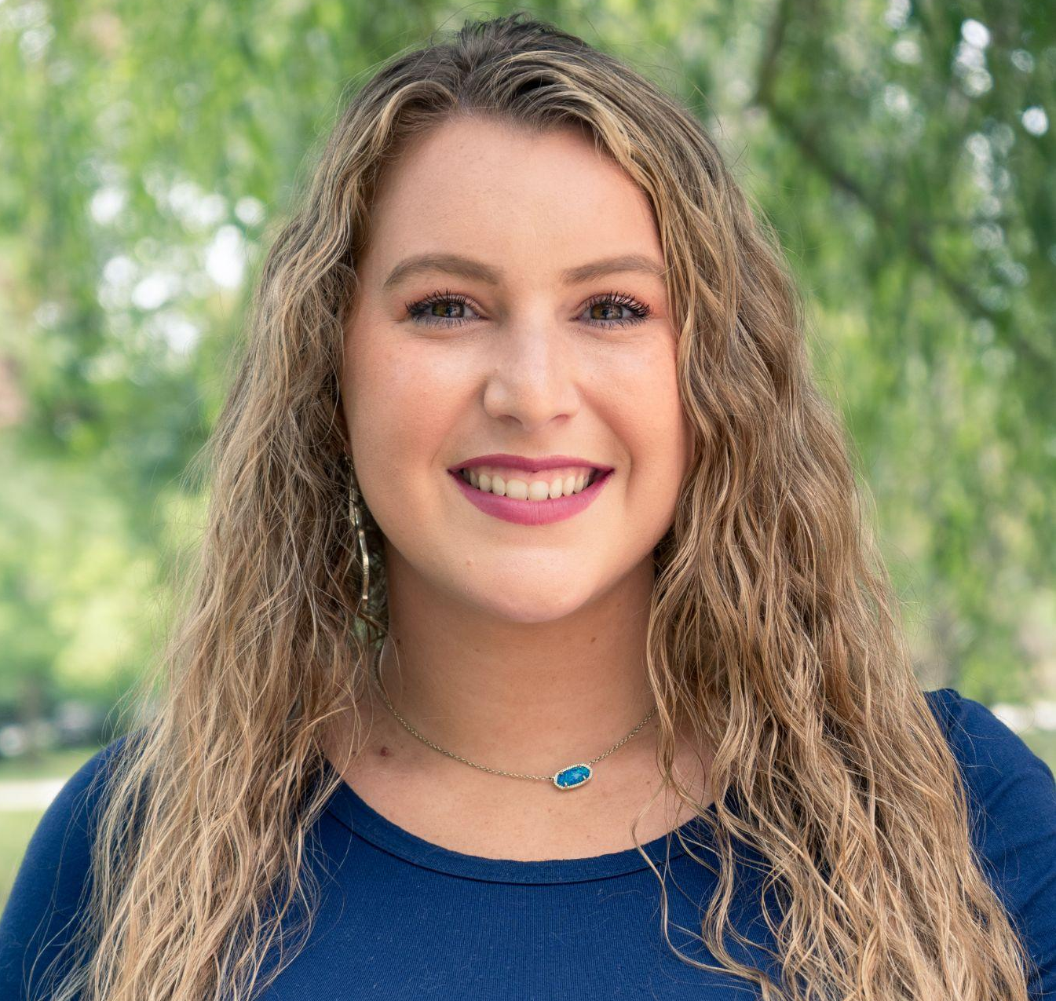
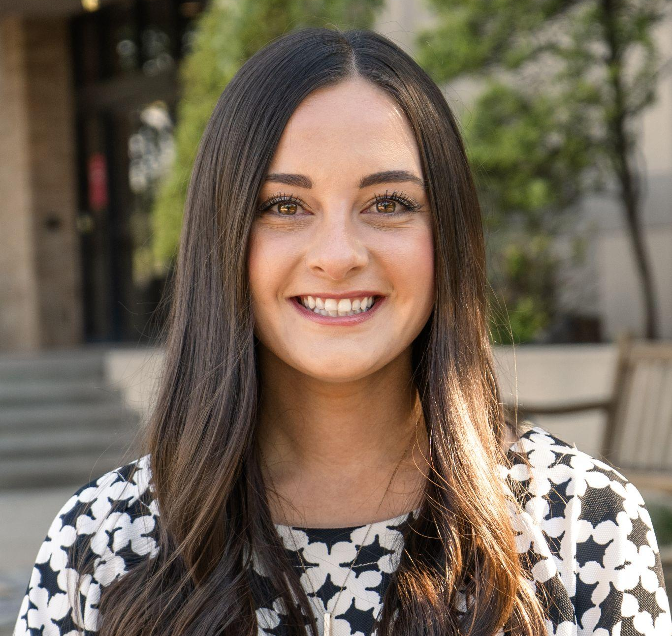
SABRINA ROLLINS, M.S
DARCI CHOI, M. Ed
Campus & Community Life Coordinator
Glenpool, OK
Univ. of Central OK and Florida State University Alumna
Project Manager
Shawnee, OK
Univ. of Oklahoma and Southern Methodist University Alumna

Slide 3
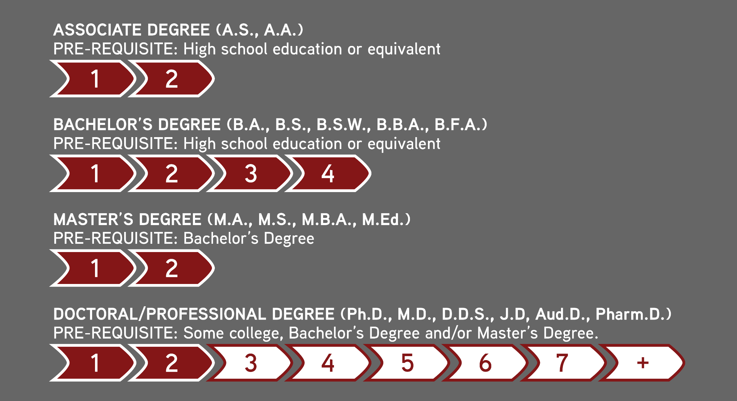
LET’S BREAK IT DOWN…

Slide 4
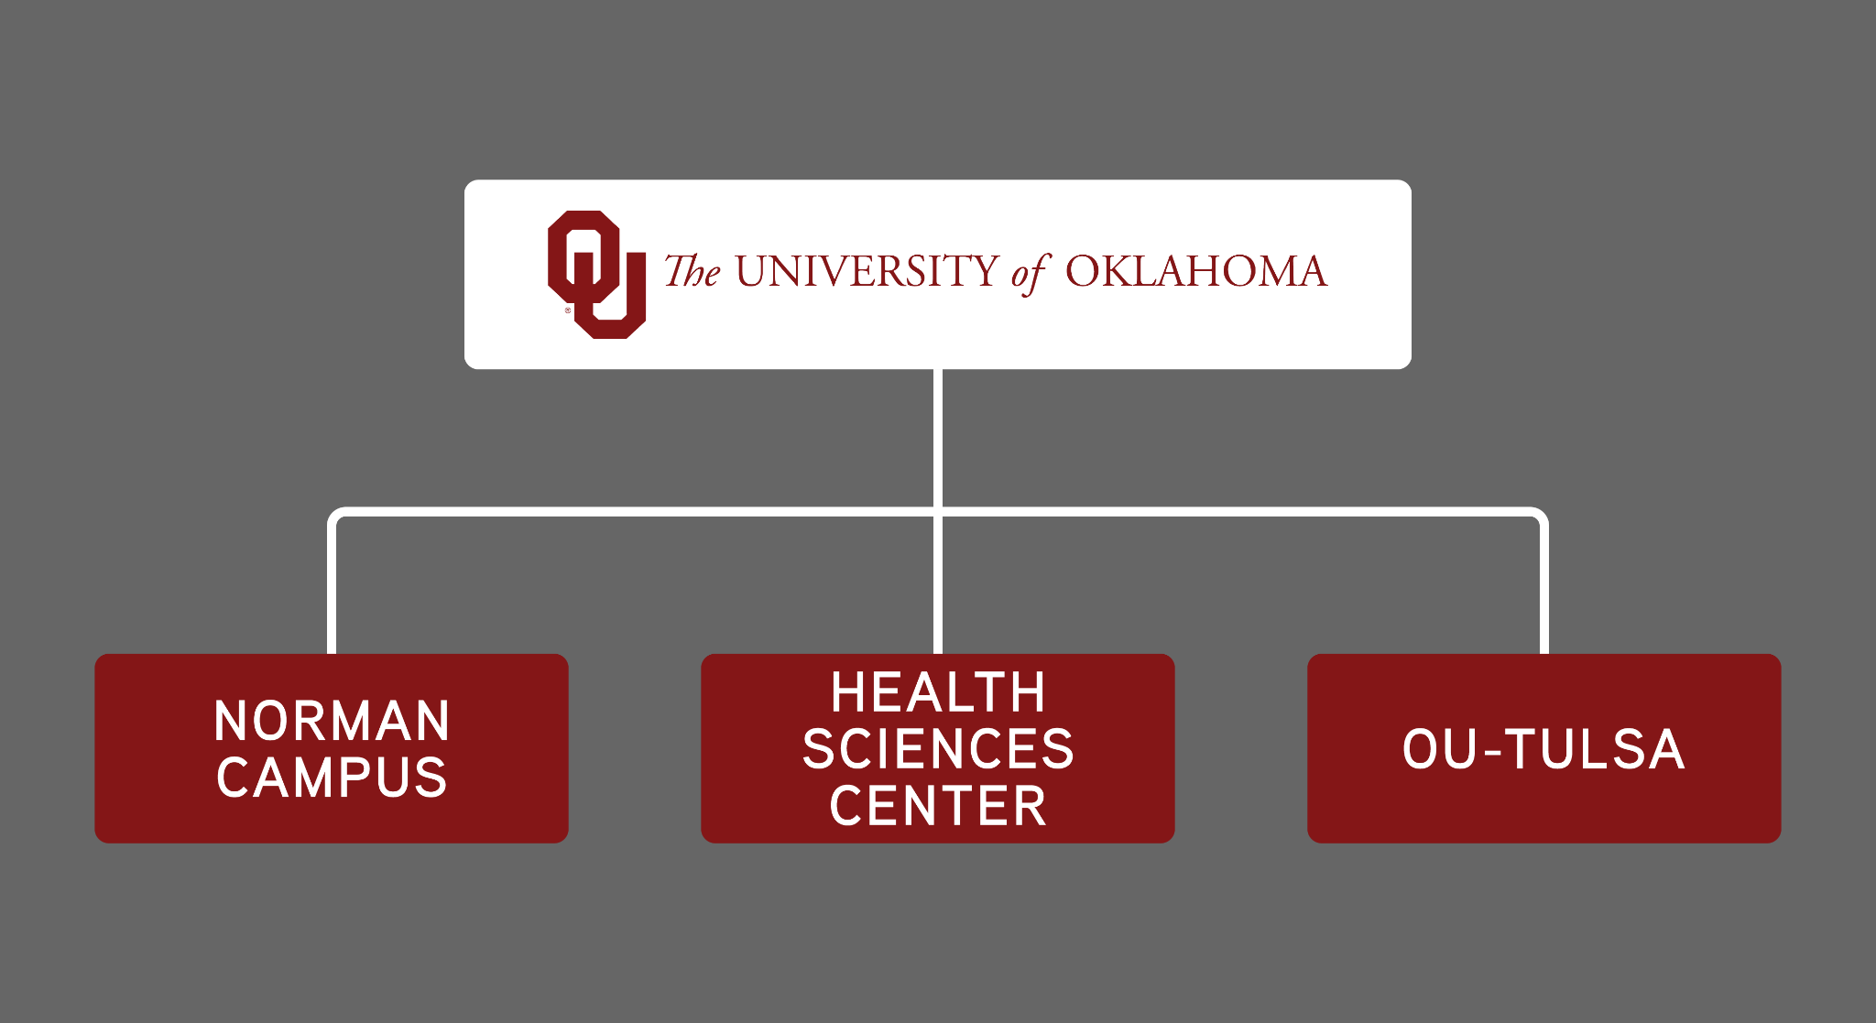
LET’S BREAK IT DOWN…

Slide 5
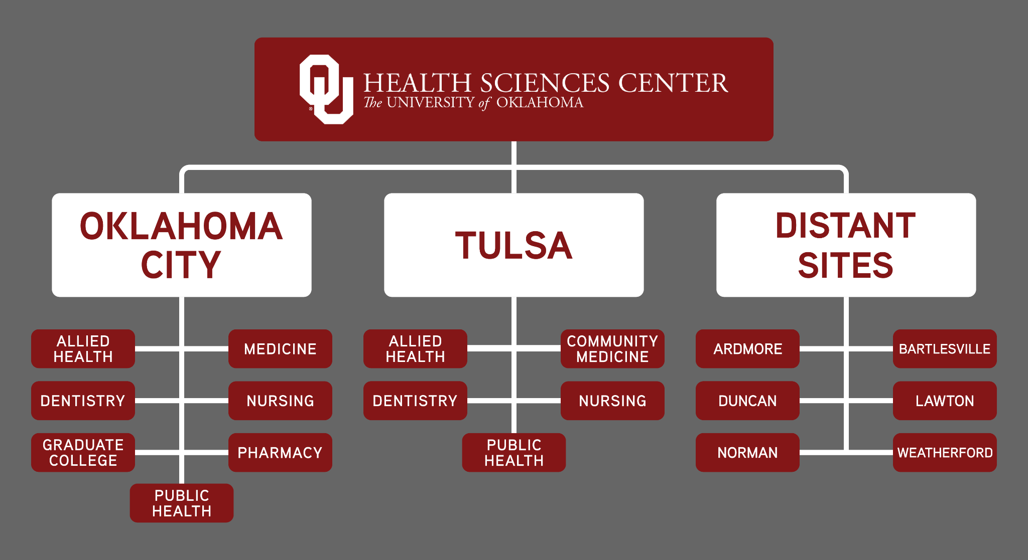
SO, WHERE CAN YOU FIND US?

Slide 6
ABCs of the HSC

Slide 7
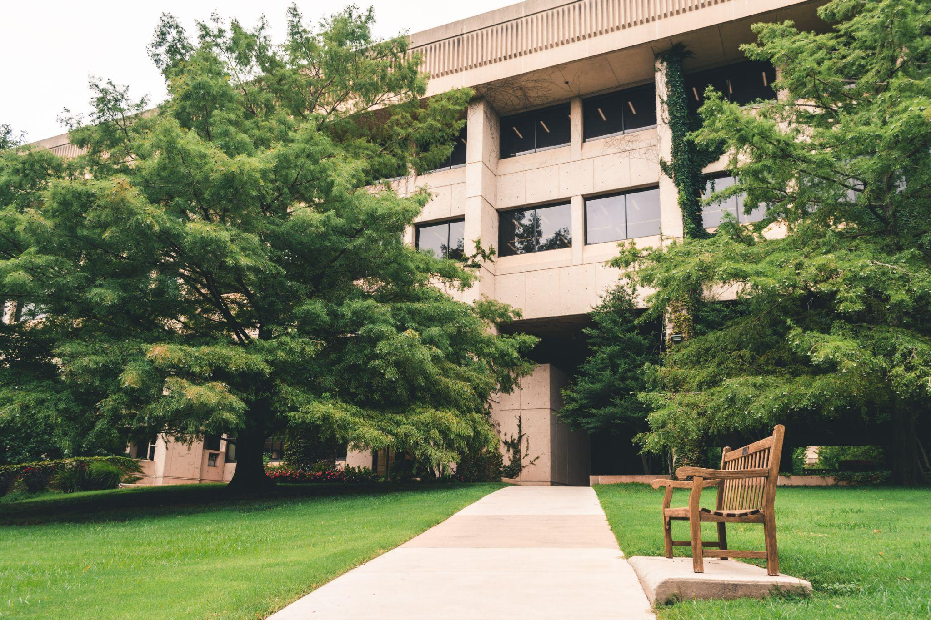
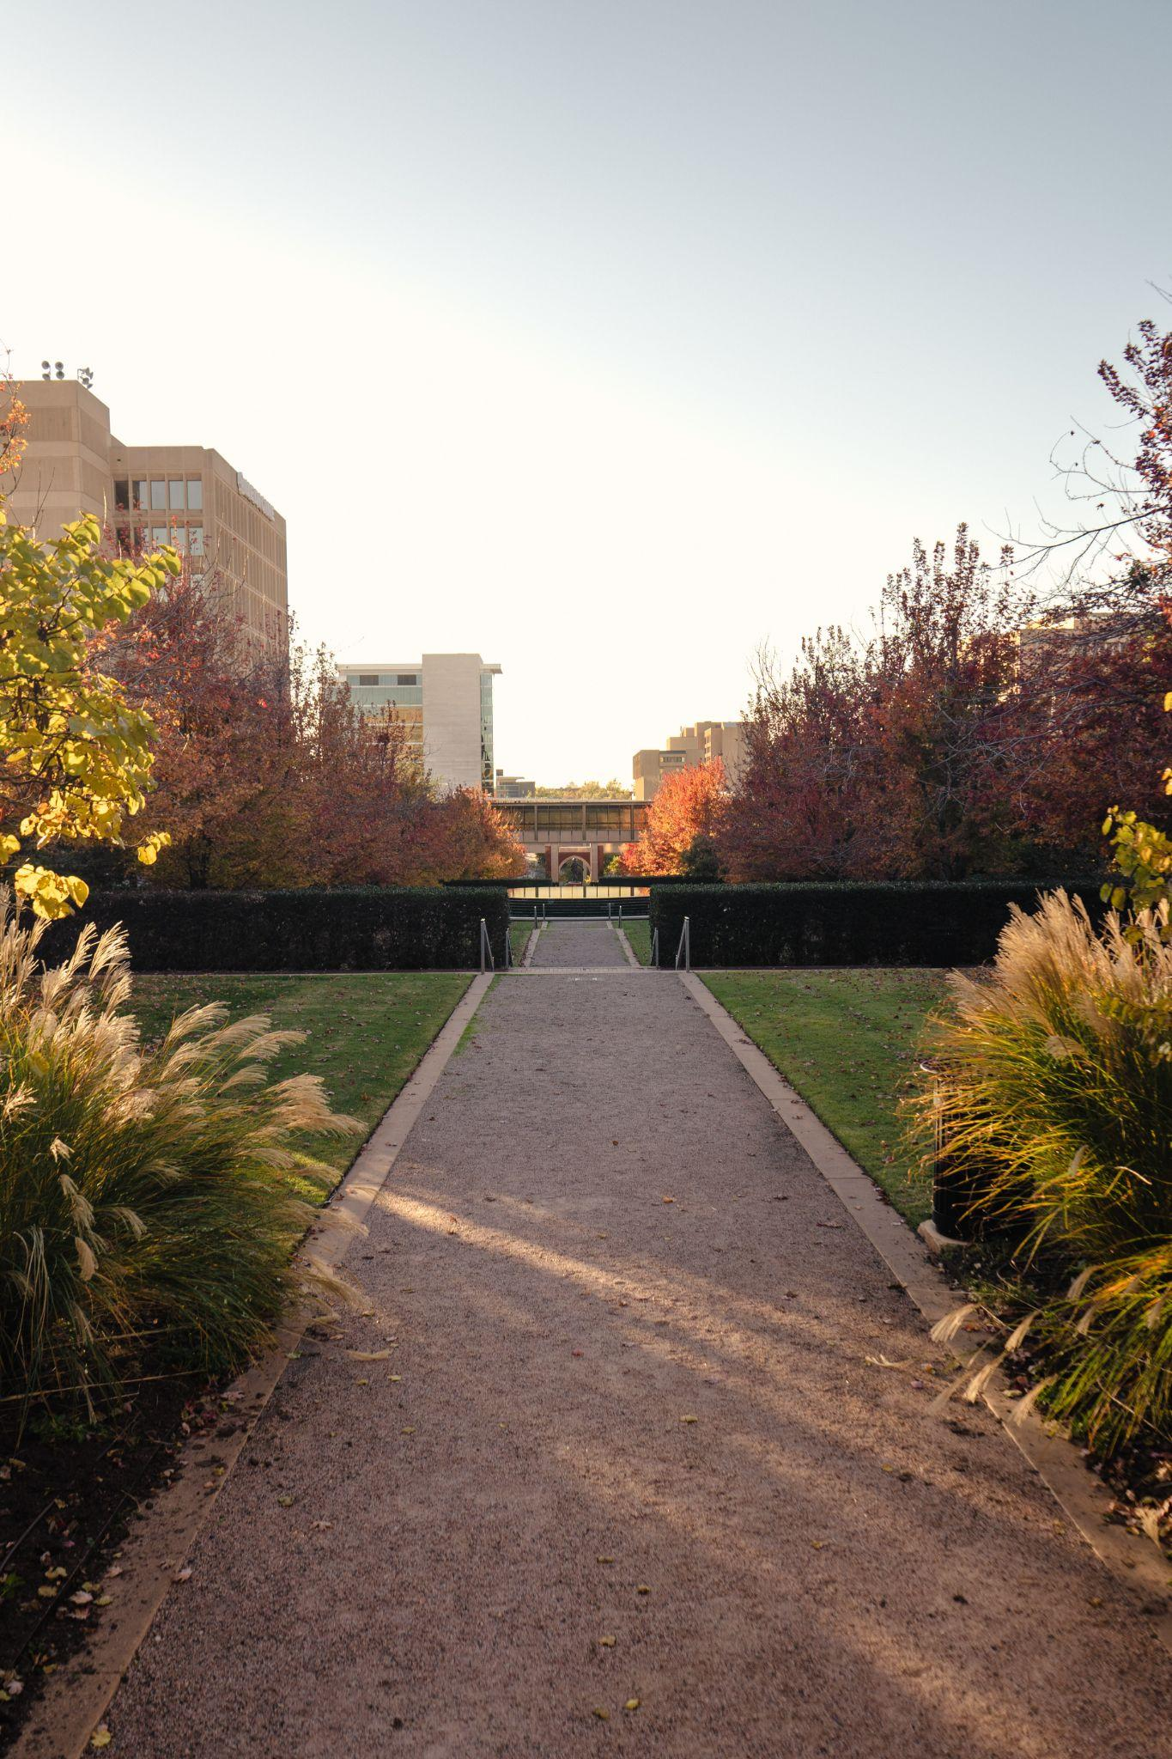
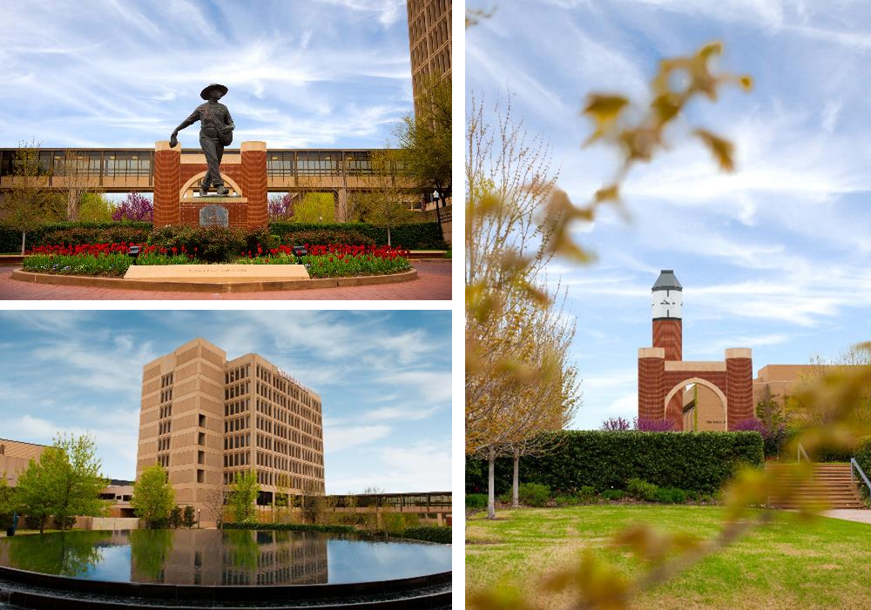
UNDERSTANDING THE OU HEALTH SCIENCES CENTER
The University of Oklahoma Health Sciences Center is one of only a few comprehensive, integrated health centers in the nation.
3350 Students
1250 Full-Time Faculty
85 Academic Programs
7 Health Professional Colleges

Slide 8
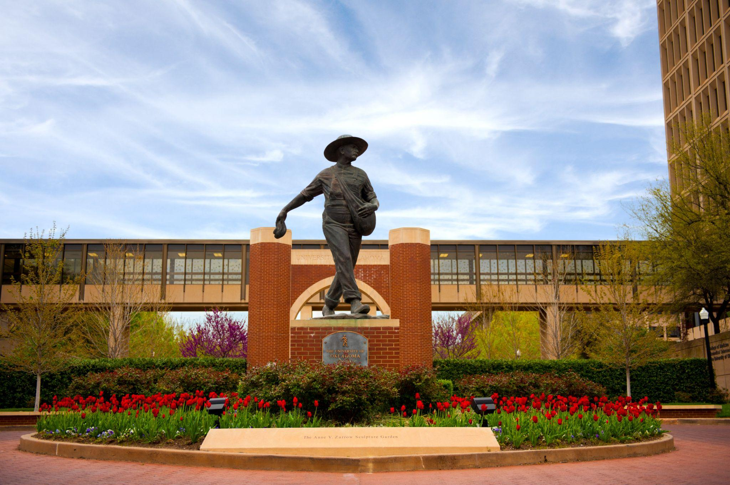
UNDERSTANDING THE OU HEALTH SCIENCES CENTER
The OUHSC is the cornerstone of the Oklahoma Health Center, nestled among OU Health, The Children’s Hospital, Harold Hamm Oklahoma Diabetes Center, Peggy & Charles Stephenson Cancer Center, OU Physicians, Oklahoma Medical Research Foundation, and more!

Slide 9
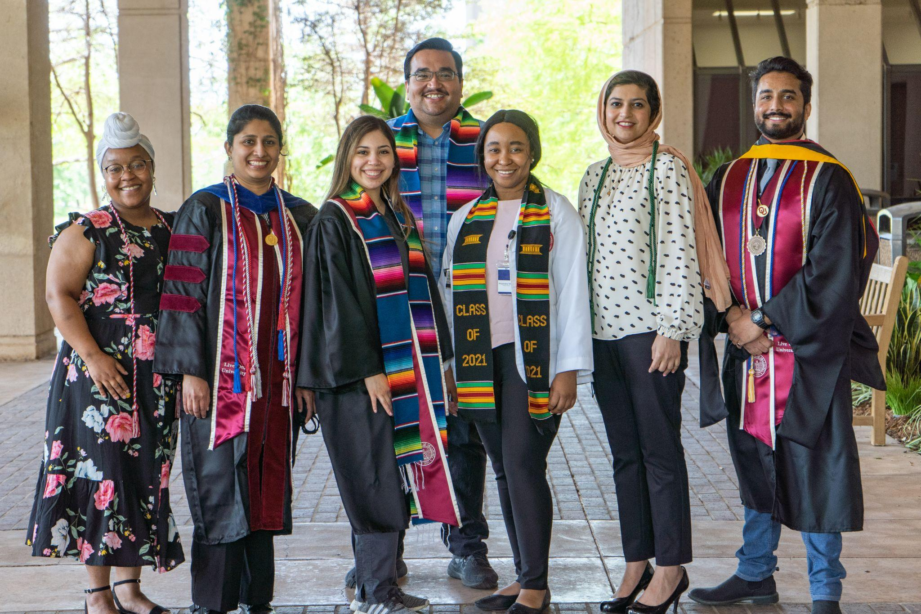
HSC STUDENT AFFAIRS
Campus Life
HSC Student Union
Multicultural Student Services
Professional Services
Recreational Services
Recruitment Services
Student Counseling Services
Student Health Services
Student Housing Services
Student Organizations
All of the traditional opportunities and campus resources that are offered to OU students exist in a unique way on the HSC campus!

Slide 10
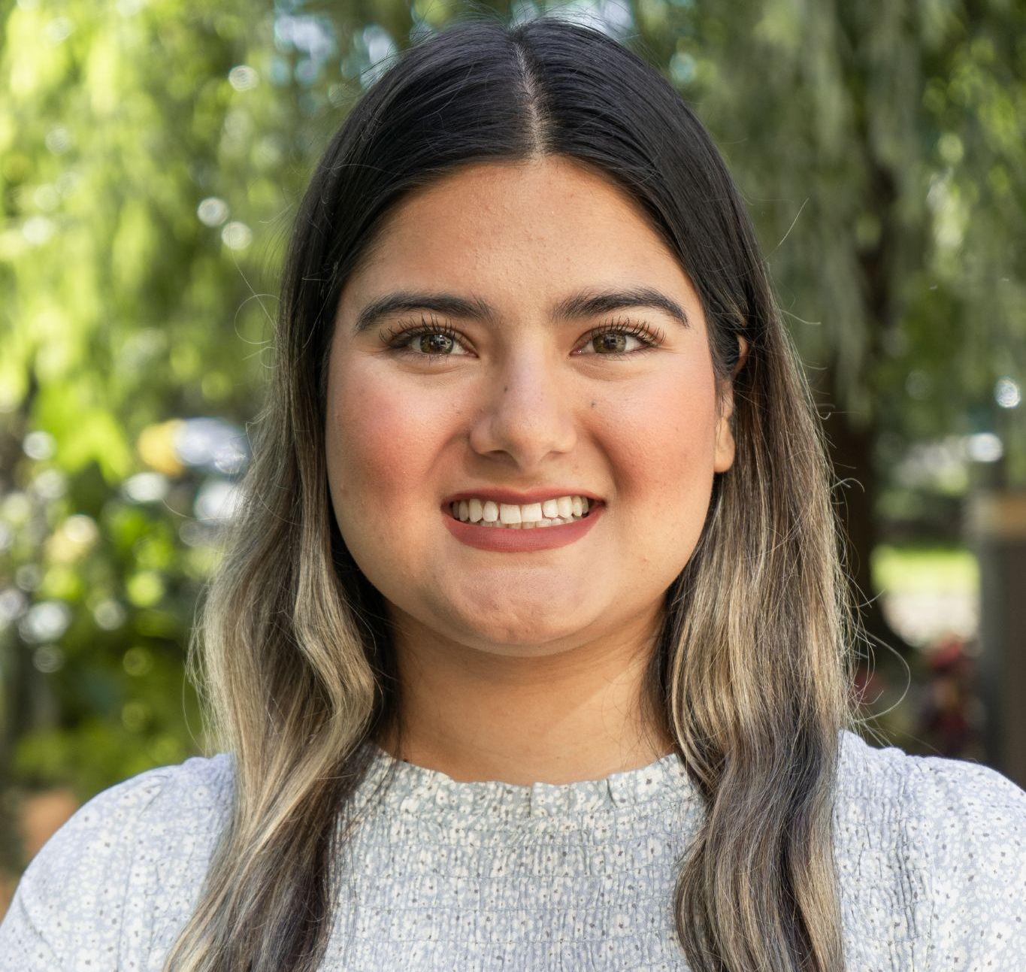
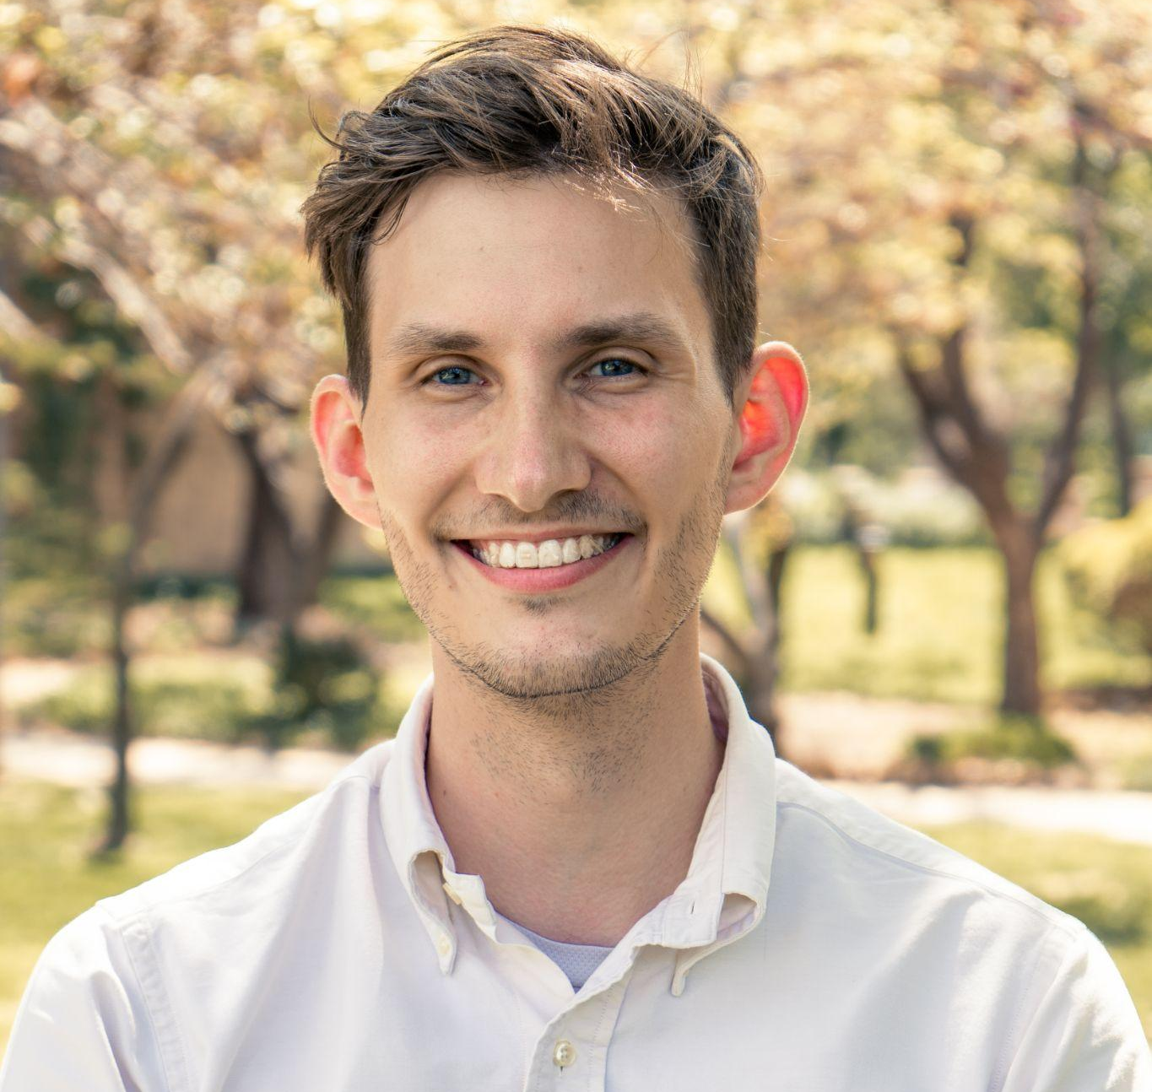
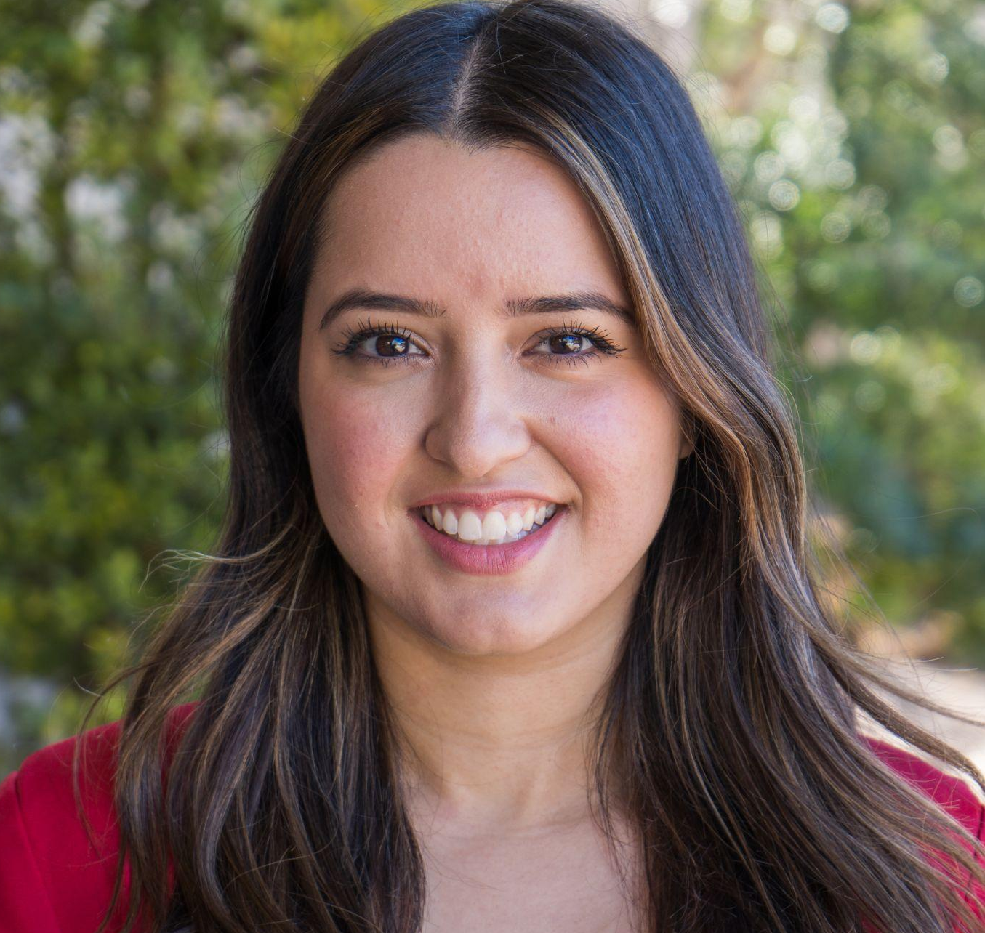
HSC STUDENT AFFAIRS
SAM BETTY, M. Ed
VANESSA CONTRERAS, M. Ed
Project Manager
Lubbock, TX
Texas Tech Univ. and Univ. of Oklahoma Alumni
Leadership & Volunteerism Coordinator
Oklahoma City, OK
OCCC and Univ. of Oklahoma Alumna
MARIA ESPARZA, MSW
Multicultural Student Services Coordinator
Edmond, OK
Univ. of Oklahoma Alumna

Slide 11
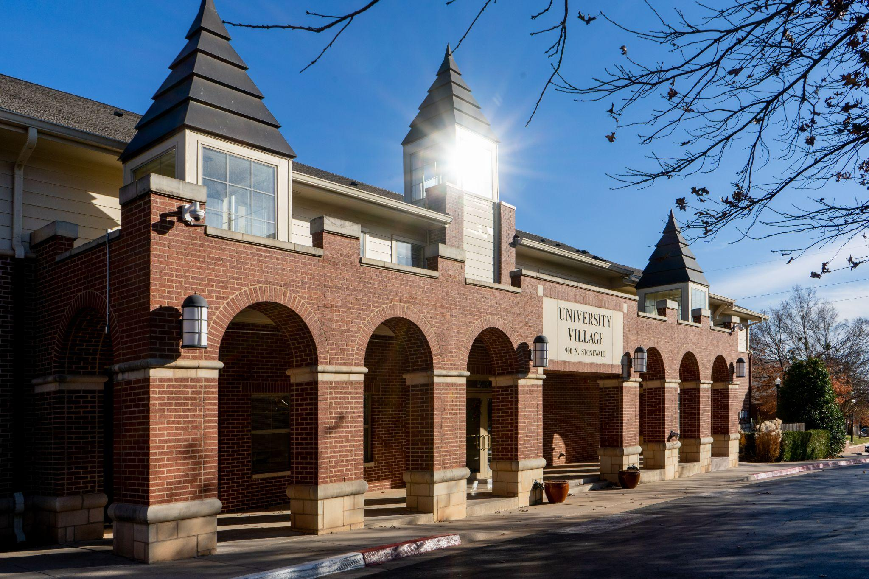
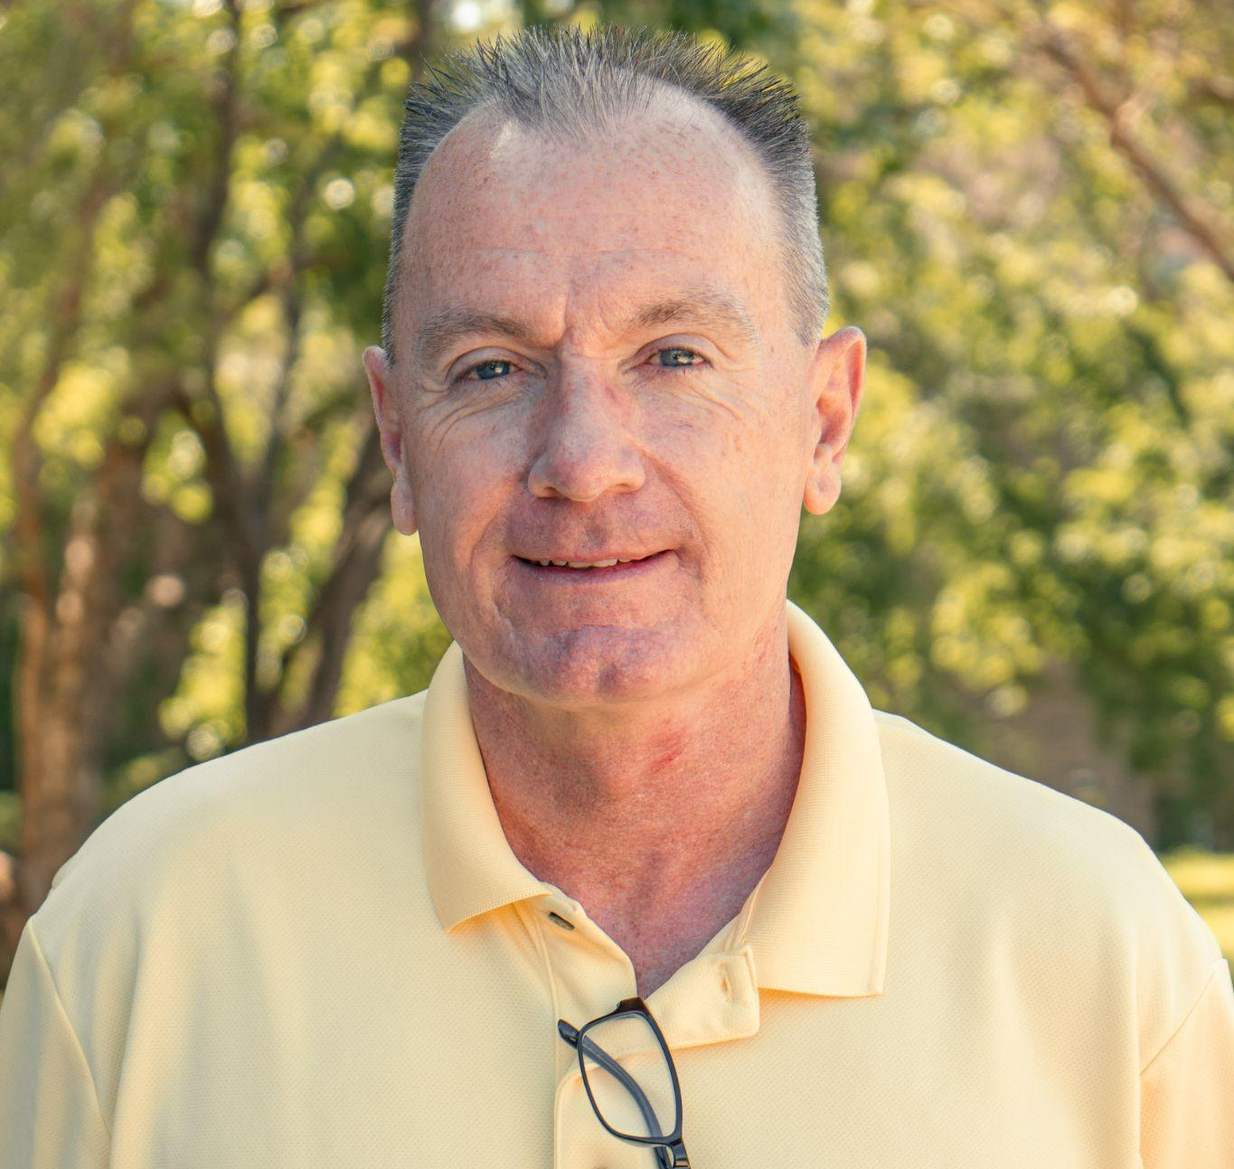
THE UNIVERSITY VILLAGE APARTMENTS
JIM WELLER
University Village Apartments Manager
Oklahoma City, OK
Univ. of Oklahoma Alumni

Slide 12
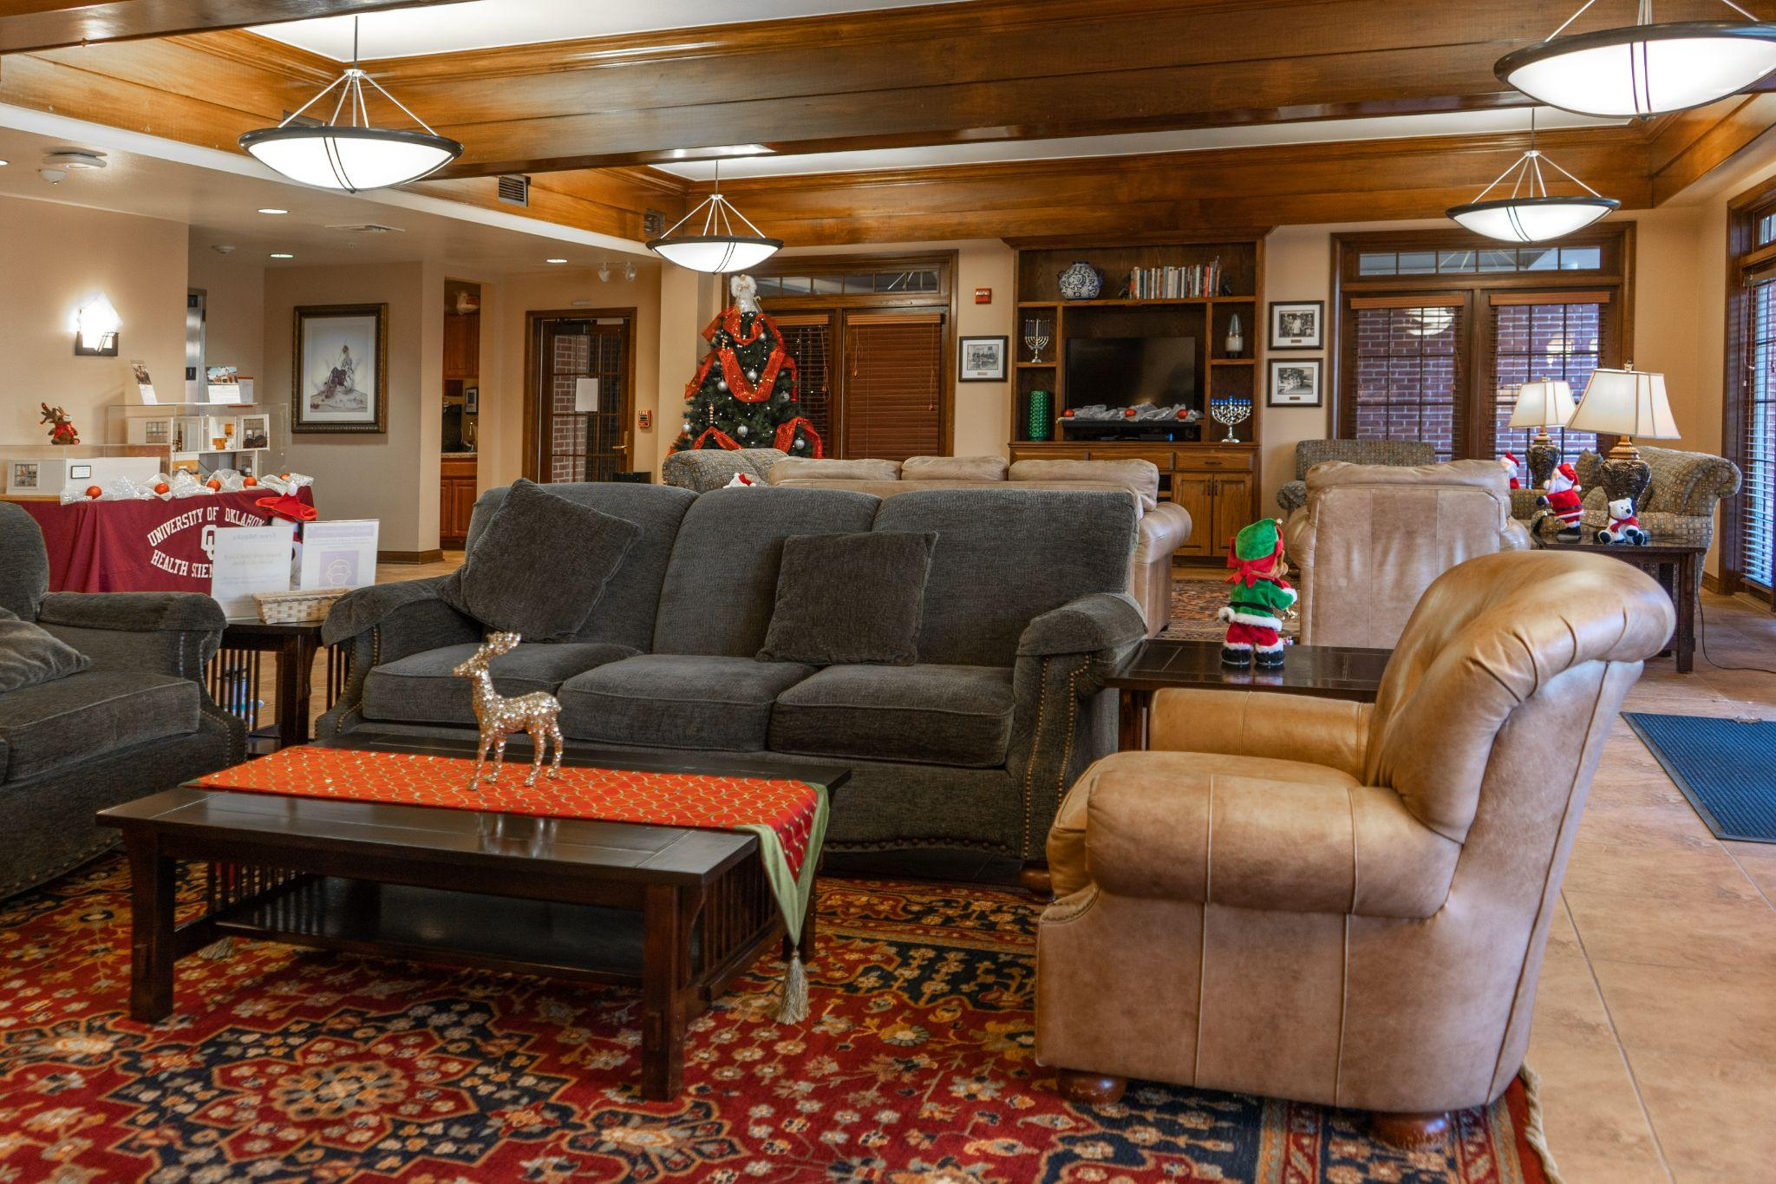
THE UNIVERSITY VILLAGE APARTMENTS
MONTHLY RENT
Studio Apartments | $681
Townhouse | $1056 - Full
Townhouse $528 - Half
AMENITIES
Water
Garbage
Cable
Sewer Service
Security Alarm
WiFi
Gated Community
Laundry Facilities
Security System

Slide 13
OUHSC CAMPUS RESOURCES
University Health Club
2 Locations; 24/7
Paid for with your student fees
Open to Students, Faculty, and Staff
Admissions & Records
Academic calendars
Course catalog
Graduation information
Office of Diversity, Equity, & Inclusion
Ensures support, advocacy, and resources
that encourages an
inclusive and welcoming campus community
Serves as the campus-wide Diversity and inclusion office
24 hour Bias Report Hotline
Financial Aid
Loan counseling
Financial management
Scholarships & waivers
Student Health Clinic
Acute & primary care
Many services covered by student health fee

Slide 14
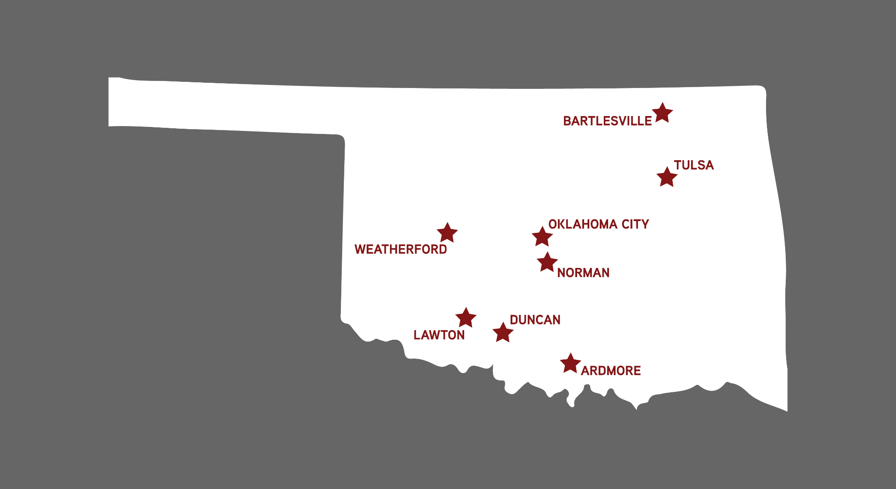
7 HEALTH PROFESSIONAL COLLEGES
Allied Health
Dentistry
Graduate College
Medicine
Nursing
Pharmacy
Public Health

Slide 15
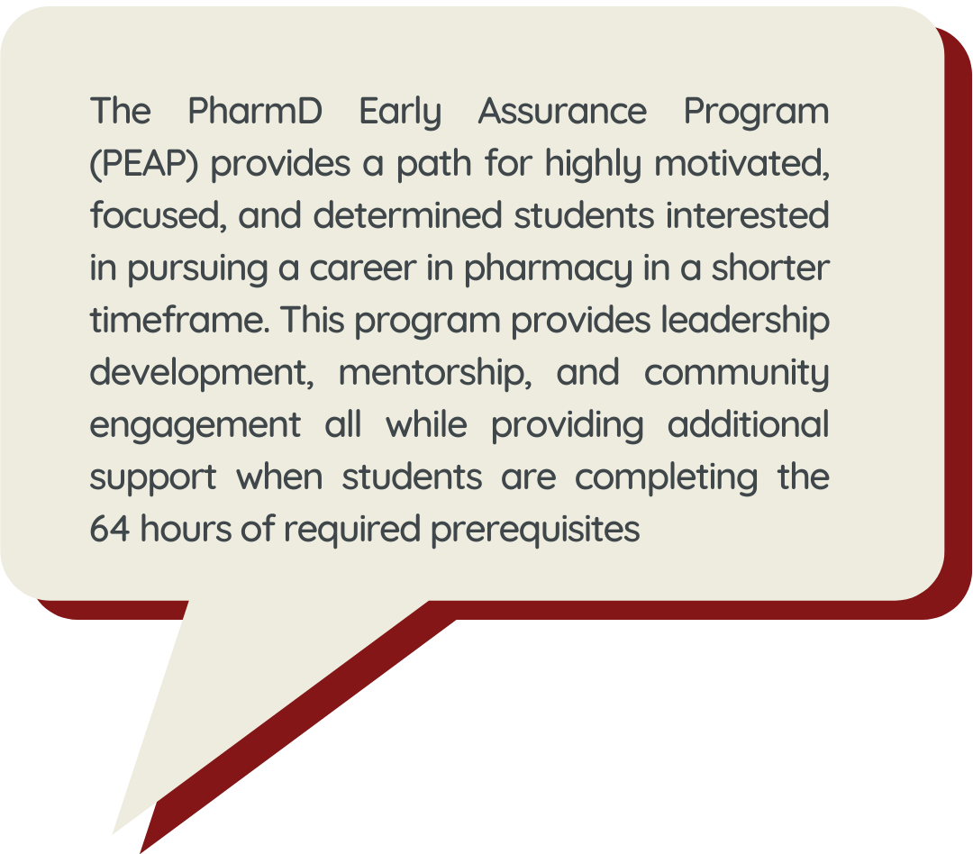
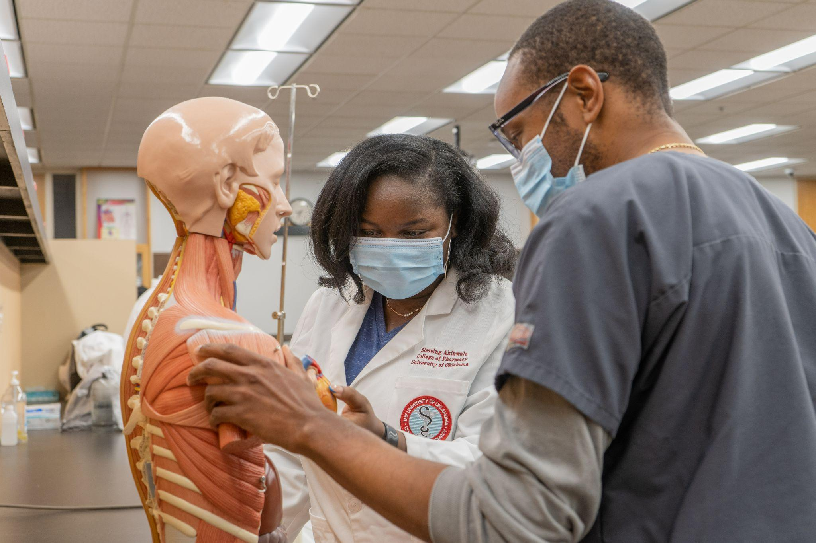
PHARMACY
Doctor of Pharmacy (PharmD)
PharmD + Master of Business Administration (MBA)
Notes:
In the verbal portion, it might be mentioned that students save money because they will only be in college courses for two years and they will not have to enroll in extraneous courses. Remaining in the program guarantees an interview for pharmacy school (not admission). Students can also take courses at any regionally accredited college or university.

Slide 16
PUBLIC HEALTH
Master of Public Health (MPH)
Interdisciplinary Public Health*
Biostatistics
Environmental Health
Epidemiology
Health Administration & Policy
Health Administration & Policy + Juris Doctorate (JD)
Health Promotion Science
Health Promotion Science + Master of Social Work
Master of Health Administration (MHA)
Master of Science
Biostatistics
Biostatistics + BS in Mathematics
Epidemiology
Health Promotion Sciences
Industrial Hygiene and
Environmental Health Sciences
Doctor of Philosophy
Biostatistics
Epidemiology
Health Promotion Sciences
Occupational & Environmental Health
Certificate in Population Health Programs
*indication of the availability at OU-Tulsa

Slide 17
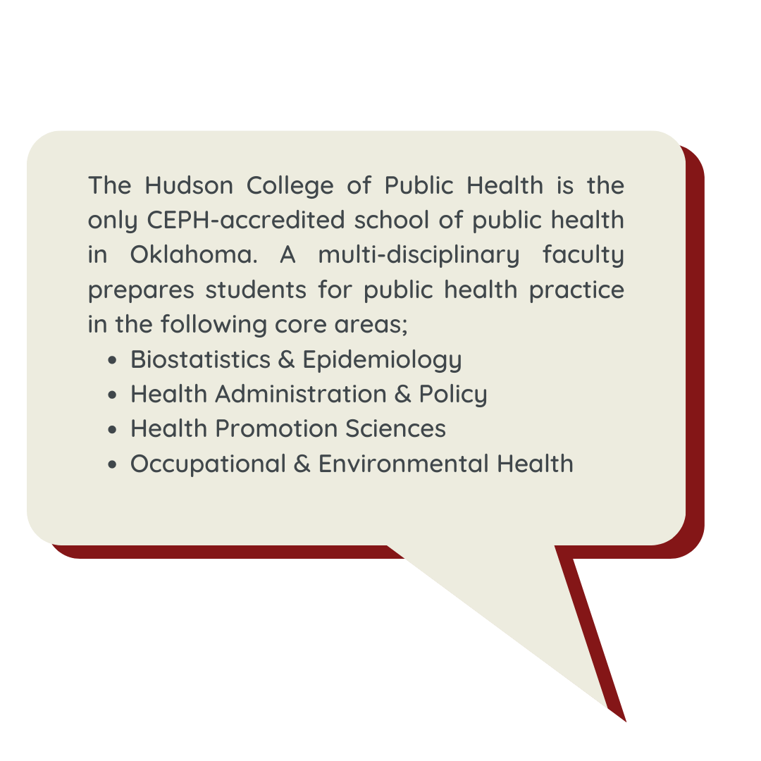
PUBLIC HEALTH

Slide 18
ALLIED HEALTH
Allied Health Sciences
PhD Programs
Communication Sciences and Disorders
BS in Communication Sciences and Disorders
MA in Speech Language Pathology
Doctor of Audiology (AuD)
PhD Programs
Nutritional Sciences
BS in Nutritional Sciences
MS in Nutritional Sciences
Medical Imaging and Radiation Sciences (MIRS)
BS in MIRS
Radiation Sciences
Nuclear Medicine
Radiation Therapy
Radiography
Sonography
Rehabilitation Sciences
Doctor of Occupational Therapy (OTD)
Doctor of Physical Therapy (DPT)
PhD Programs
Notes:
Programs

Slide 19
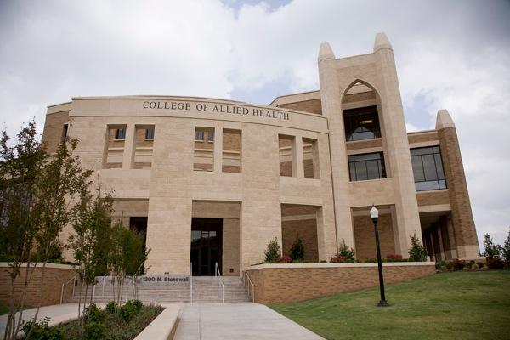
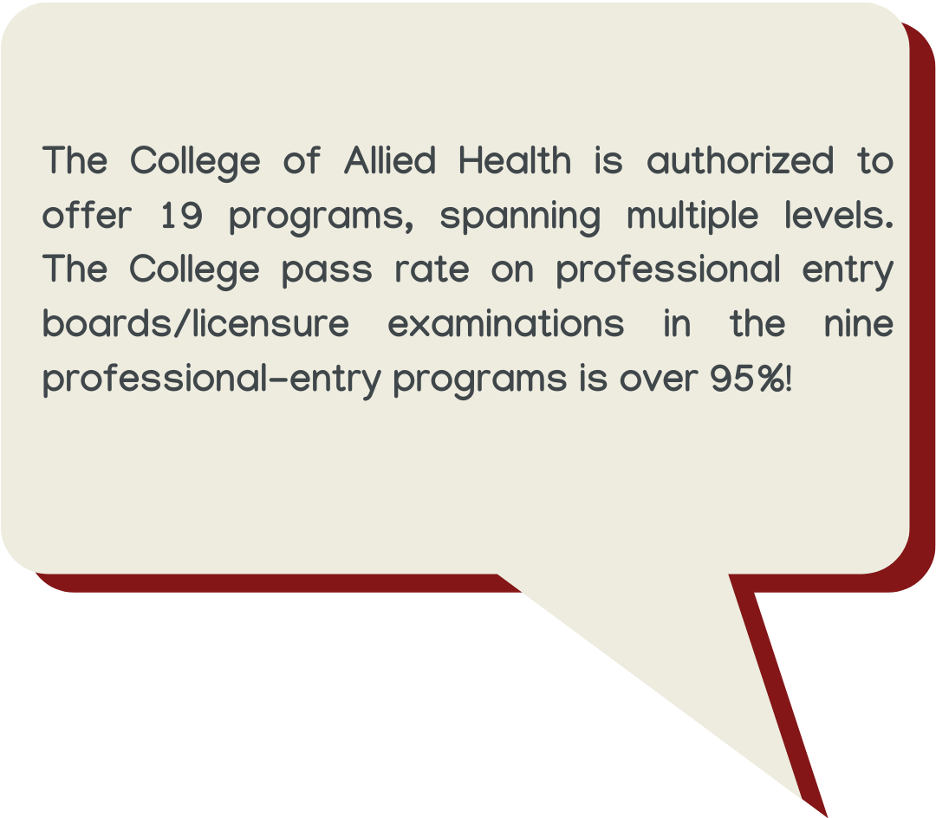
ALLIED HEALTH

Slide 20
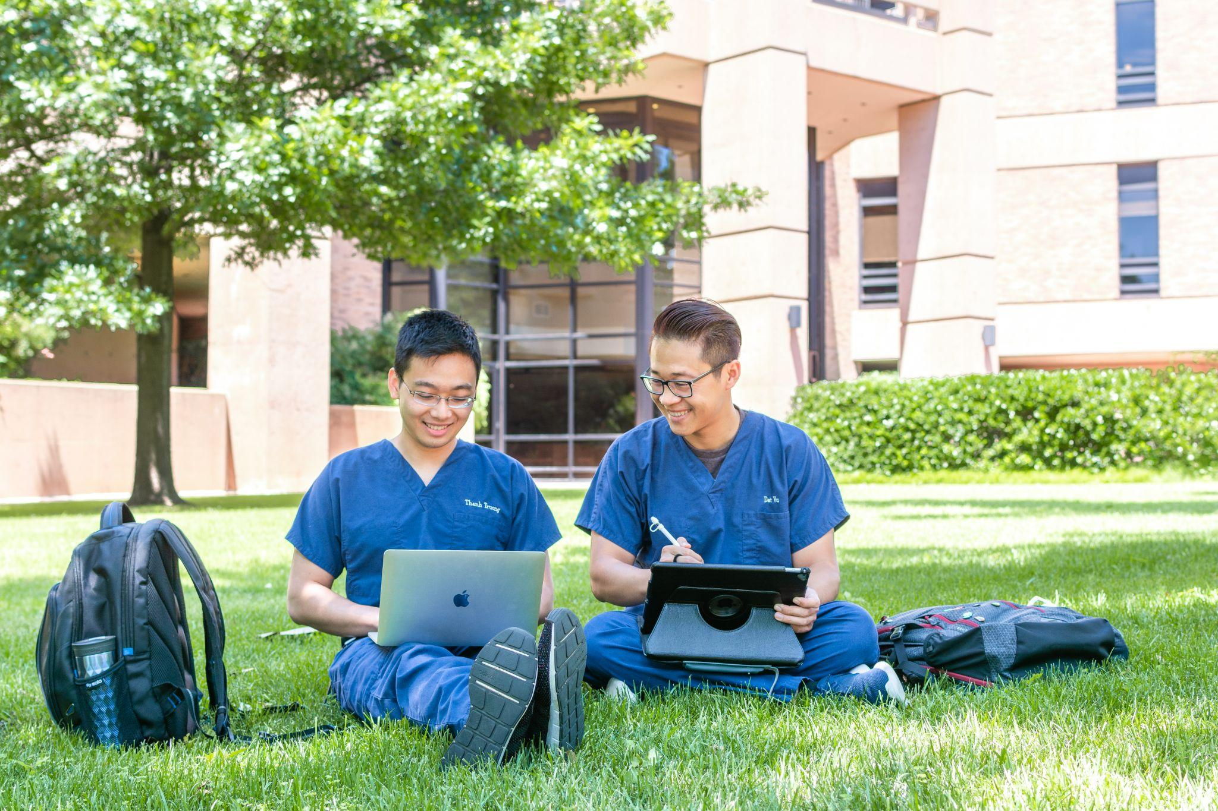
DENTISTRY
BS in Dental Hygiene (BSDH)
Doctor of Dental Surgery (DDS)

Slide 21
HSC GRADUATE COLLEGE
Allied Health
Allied Health Sciences (MS/PhD)
Communication Sciences & Disorders (MS/PhD)
Nutritional Sciences (MS)
Medicine
Biochemistry & Molecular Biology (MS/PhD)
Cell Biology (PhD)
Microbiology & Immunology (PhD)
Neuroscience (MS/PhD)
Pathology (MS/PhD)
Physiology (MS/PhD)
Genetic Counseling (MS)
Radiological Sciences (MS/PhD)
MD/PhD
Dentistry
Orthodontics (MS)
Periodontics (MS)
Nursing
Multiple Tracks (MS/PhD)
Interdisciplinary
Clinical &
Translational Science (MS)
Pharmaceutical Sciences
MS/PhD
PharmD/MS
Public Health
Biostatistics (MS/PhD)
Epidemiology (MS/PhD)
Health Promotion Sciences (MS/PhD)
Occupational & Environmental Health (MS/PhD)
The Graduate College oversees research-based MS & PhD programs in Biomedical & Health Sciences, in collaboration with the other 6 colleges!

Slide 22
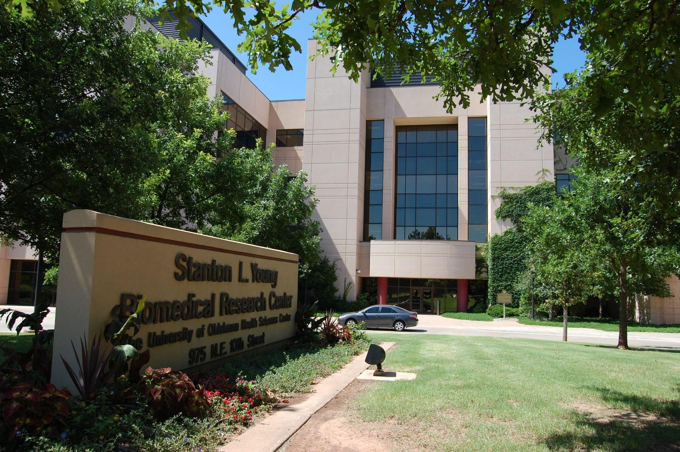
GRADUATE PROGRAM IN BIOMEDICAL SCIENCES
The Graduate Program in Biomedical Sciences serves as the primary entry point for students pursuing a PhD in Biomedical Sciences.
Notes:
Programs
Fun fact about the college
New To You Profession
**Add info about GPiBS

Slide 23
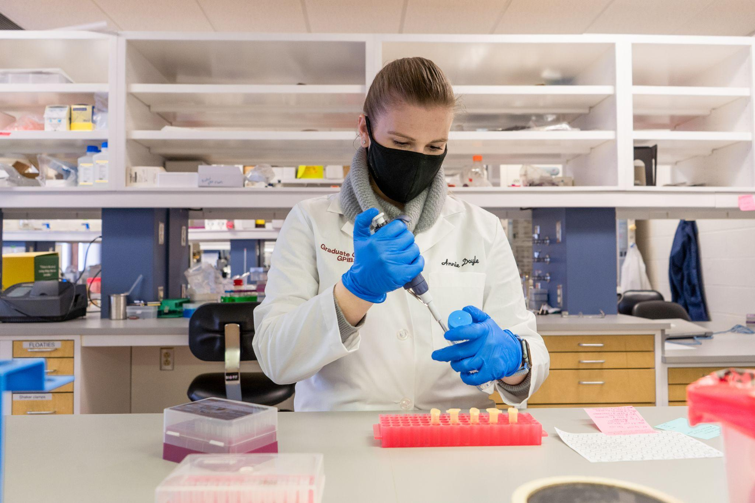
GRADUATE PROGRAM IN BIOMEDICAL SCIENCES
Biochemistry & Molecular Biology
Cell Biology
Microbiology & Immunology
Neuroscience
Pathology
Pharmaceutical Sciences
Physiology
Notes:
Programs
Fun fact about the college
New To You Profession
**Add info about GPiBS

Slide 24
NURSING
Bachelor of Science in Nursing Tracks
(Traditional) Bachelor of Science in Nursing (BSN)
Accelerated Bachelor of Science in Nursing ABSN
Licensed Practical Nurse (LPN) to BSN
Registered Nurse (RN) to BSN
Master of Science in Nursing (MS)
MSN: Administration/Management Pathway
MSN Clinical Nursing Specialist
Doctoral Programs
Doctor of Nursing Practice (DNP)
PhD in Nursing
Post Graduate Certificates
Education
Clinical Nurse Specialist
Family Nurse Practitioner
Neonatal Nurse Practitioner
Psychiatric Mental Health
Nurse Practitioner
Campus Locations:
Oklahoma City, OK
Tulsa, OK
Lawton, OK
Norman, OK
Duncan, OK

Slide 25
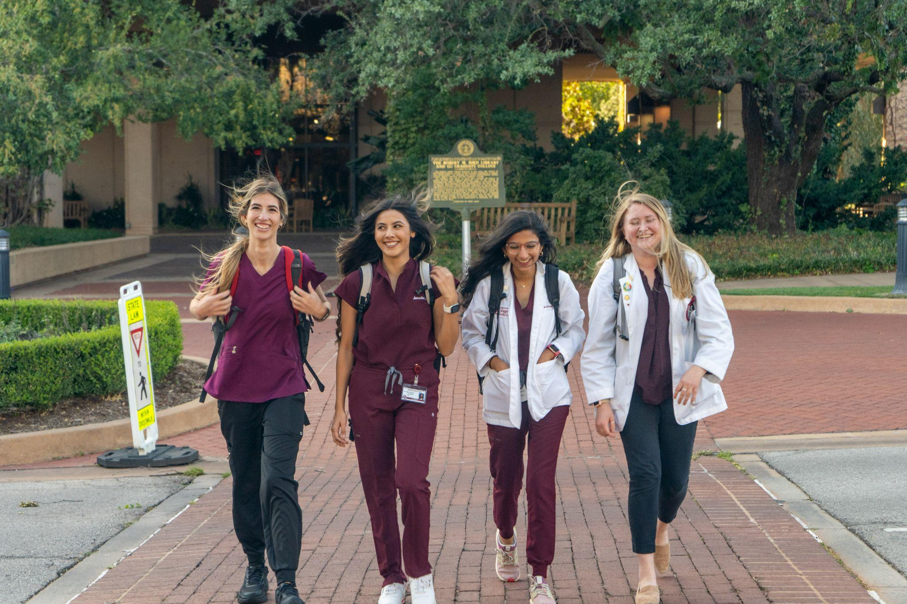
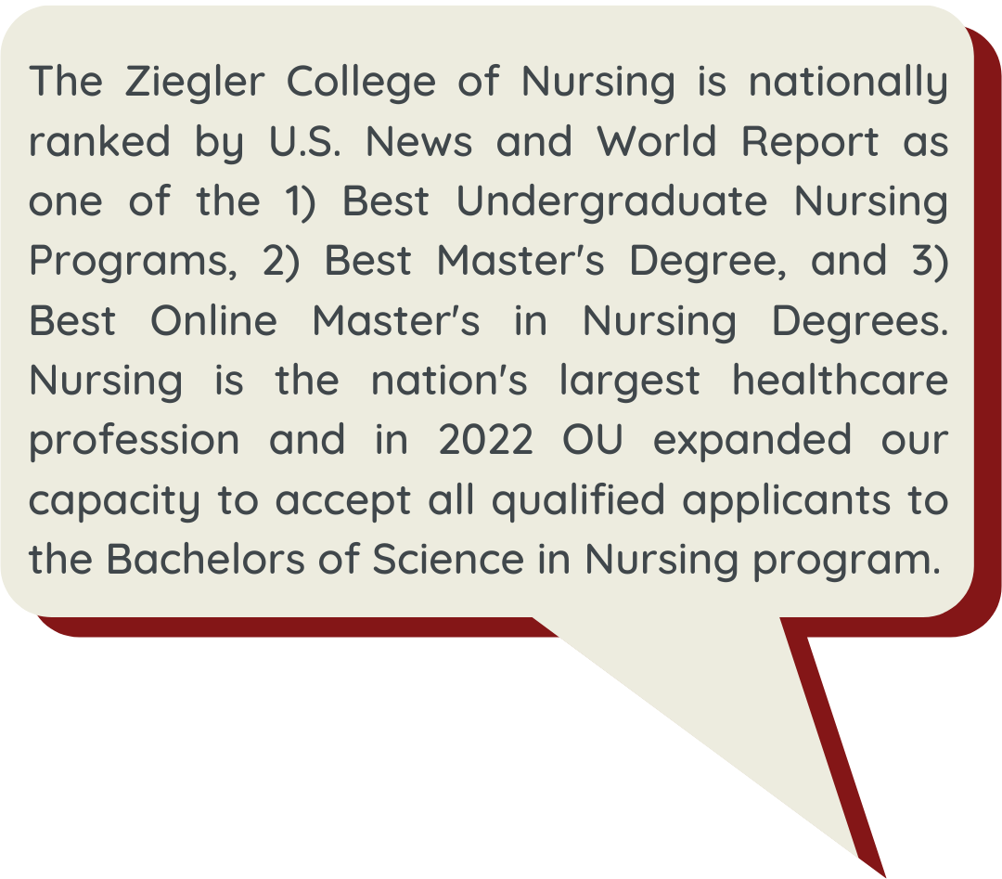
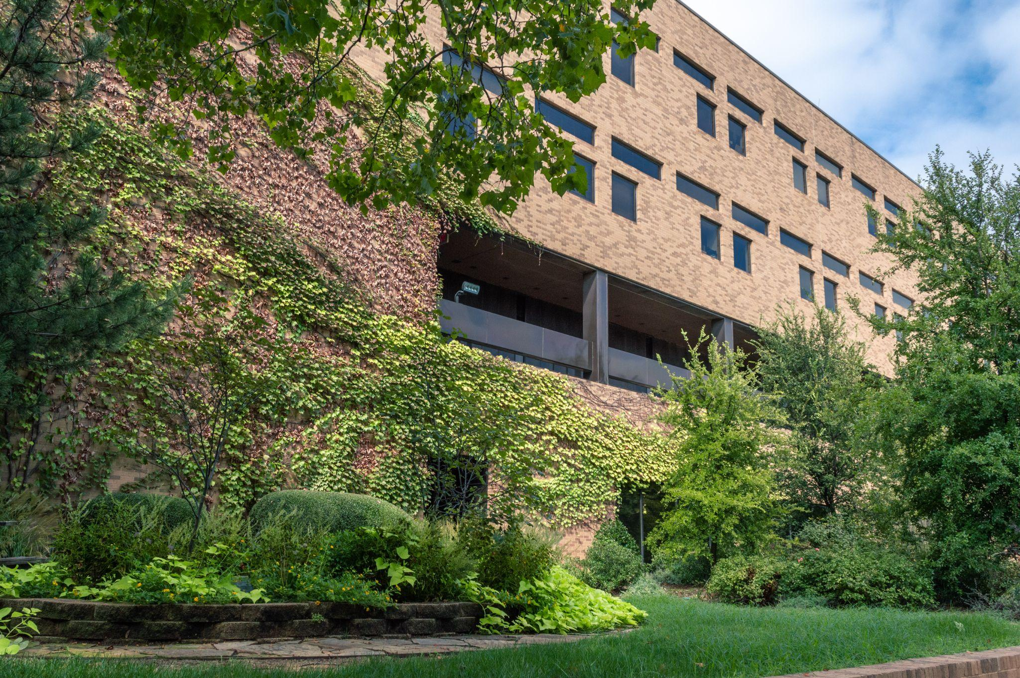
NURSING

Slide 26
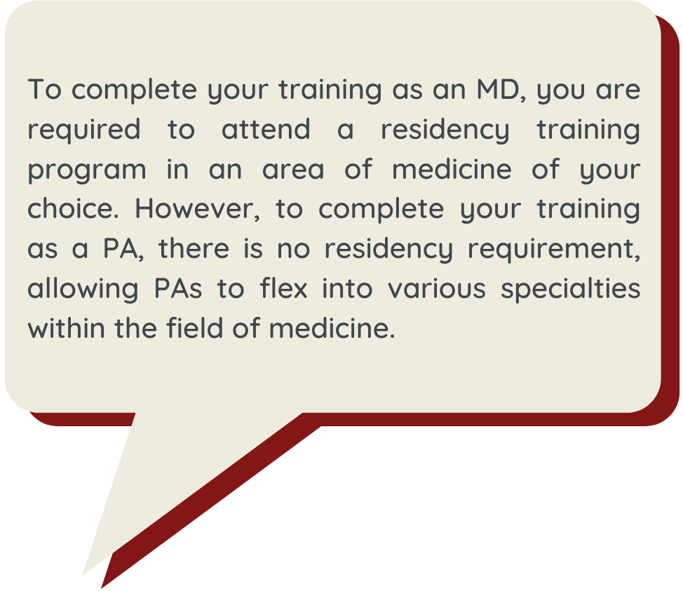
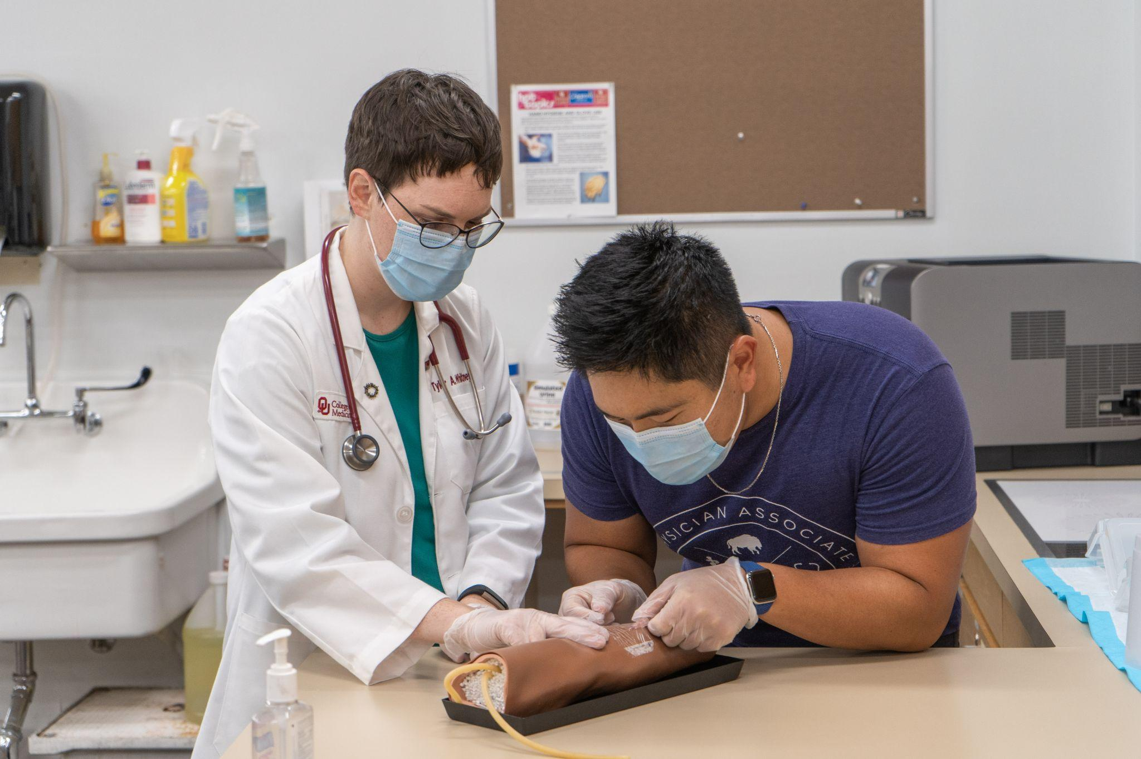
MEDICINE
Doctor of Medicine (MD)
MD/Master of Public Health (MPH)
Physician Associate (MHS)
Campus Locations:
Oklahoma City, OK
Tulsa, OK

Slide 27
PREPARING FOR YOUR APPLICATION
Get into college!
Concentrate on academics
Join pre-professional clubs
Shadow health professionals
Explore various careers
Review admissions timeline
Take applicable graduate admissions exam(s)
Keep in touch with us at discover.ouhsc.edu!

Slide 28
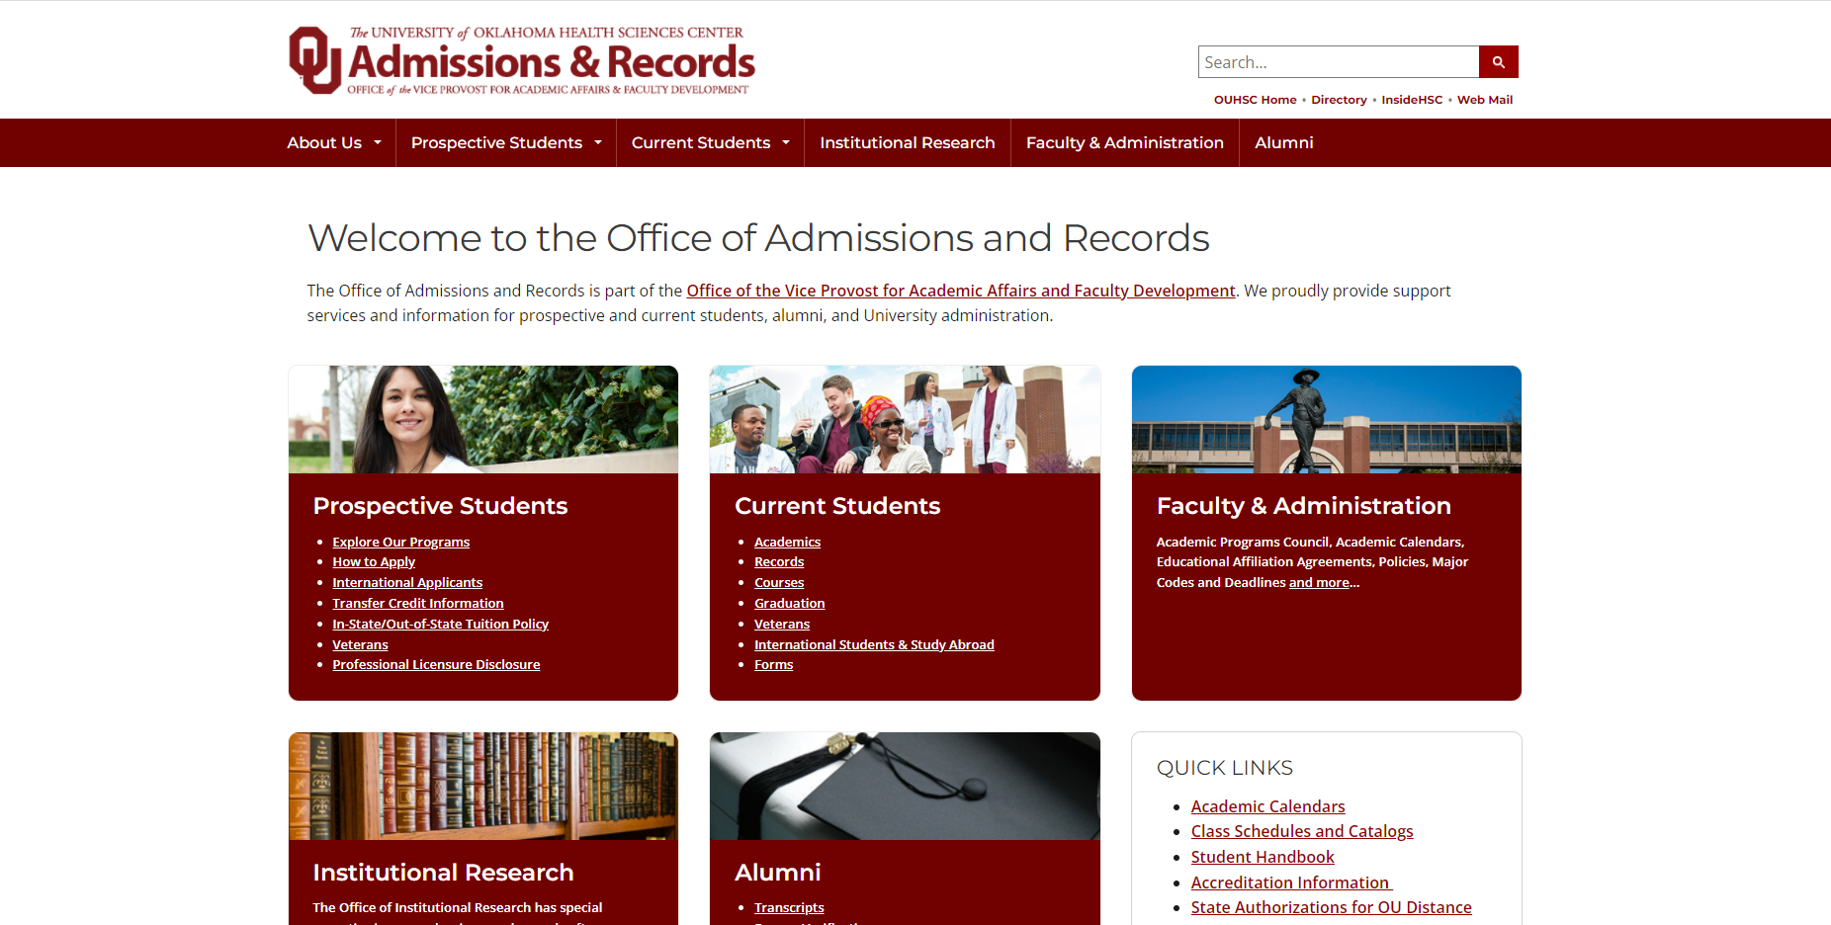
HOW TO APPLY?
Step 1: Visit go2.ouhsc.edu
Step 2: Under “Prospective Students” Click “How to Apply”

Slide 29
VISIT CAMPUS!
Scan to book a tour!
HSC Student Affairs
1106 N. Stonewall Ave.
Suite 300
Oklahoma City, OK 73117
students@ouhsc.edu
405-271-2416

Slide 30
UPCOMING EVENTS
Prospective Student Calendar includes:
HSC Student Affairs opportunities
Individual academic college programs
Community-wide engagement events
Twitter/Instagram: @hscstudent
Facebook: facebook.com/uoklahomahsc

Slide 31
QUESTIONS?

Slide 32
END OF SLIDES

